Slide 1


IGNITE Student Internship Program
Title of the Work: Hybrid Ground Station
Team members :Nivya D,N Nikhilesh
Internal Mentor :Ankitha A
External Mentor: Supriya M S
Name of the College : Vemana Institute Of Technology

Slide 2
Problem Statement and objectives
Design and development of hybrid ground station for drone and cubesat.
Objectives
To do the literature survey on ground station of drone and cubesat.
To collect the relevant dataset from github repository
To design a ground station circuit for drone and cubesat.
To implement a designed hybrid ground station.
To validate the developed model.

Slide 3
Literature Review
Drone Ground Control Station with Enhanced Safety Features,Syed Razwanul Haque, Robi Kormokar, Akhlak Uz Zaman.
‘Drone Ground Control Station’ is a system for controlling and monitoring Unmanned Aerial Vehicle (UAV) or Drone from any remote place.
In existing non-military drone ground control stations, the software can only present the telemetry data and control parameters from drone, which do not ensure the safety of an on flight drone from crashing due to bad weather and other facts..
This paper is about a drone control station which incorporates a hardware system for establishing secured communication with drone and a software for presenting the telemetry data as well as the important weather parameters

Slide 4
Literature Review
Small Satellite Ground Station in Pilsen – Experiences with VZLUSAT-1 Commanding and Future Modifications Toward Open Reference Ground Station Solution.
Conventional solution of the ground station for CubeSat commanding during low Earth orbit mission is based on radio amateur equipment and could be implemented quickly and with low cost.
In this paper several practical experiences with radio commanding of CubeSat class satellite are described, especially limitations of conventional solutions of the ground station and several aspects of collective launch of small satellites.
usable for different satellites and with the capability of linking into the network of cooperated ground stations, while keeping low cost and usage of currently common equipment like software defined radio.

Slide 5
Literature Review
Design and development of ground station for UAV/UGV heterogeneous collaborative system, Xiao Liang,Shirou Zhao , Guodong Chen b , Guanglei Meng , Yu Wang.
This paper designs and establishes a ground station for UAV/UGV heterogeneous collaborative system. According to the functional requirements of UAV/UGV heterogeneous collaborative system.
The serial communication based on multi-thread improves the efficiency of ground station when receiving, processing, and sending data.
In the experiments of collaborative tracking, the improved ECO algorithm can balance the accuracy and real-time performance when tracking.
In digital map module, the improved ant colony algorithm can find an optimal path based on pre-processed digital map.

Slide 6
Literature Review
An optimal location strategy for multiple drone base stations in massive MIMO. Manuel Eugenio Morocho-Cayamcelaa,Wansu Limb , Martin Maier.
In this paper they proposed an alternative cost function that minimizes the received signal strength instead of the conventional metric distance.
The concept of drone base stations (DBSs) has been applied to reduce the distance of the wireless link between a macro base station and its active users under diverse scenarios in military communications, smart industries, and high-density networks, and to provide service in topologies with damaged infrastructure.
The optimal positioning of multiple DBSs in a multiple-input multiple-output wireless network setting. We present a low-complexity machine learning-based algorithm to optimize the location of the DBSs by minimizing the collective wireless received signal strength experienced by the active terminals.

Slide 7
Literature Review
MAVSec: Securing the MAVLink Protocol for Ardupilot/PX4 Unmanned Aerial Systems Azza Allouch, Omar Cheikhrouhou, Anis Koubaa, Mohamed Khalgui, Tarek Abbes.
The MAVLink is a lightweight communication protocol between Unmanned Aerial Vehicles (UAVs) and ground control stations (GCSs). It defines a set of bi-directional messages exchanged between a UAV (aka drone) and a ground station.
MAVLink can guarantee its messages confidentiality, without affecting its performance, while occupying less memory and CPU consumption, thus, preserving memory and saving the battery for the resource-constrained drone.

Slide 8
Literature Review
Development of an intelligent UAV-based monitoring and mapping system for recording the weed distribution in wheat fields (weed-AI-seek) Jing Liu1, Pendar Alirezazadeh2, Tom Kaufmann3, Michael Schirrmann2, Ludwig Schrenk3, Frieder Stolzenburg.
Artificial intelligent systems have a great potential for identifying objects in unstructured data such as images. Unmanned aerial vehicles (UAV) open up new perspectives for weed monitoring because it enables very high-resolution remote sensing imagery (VHR) from which weed plants can be outlined even on the species-level.
In this paper, a UAV platform is combined with an AI system (WeedAI) for wide-area real-time weed monitoring and mapping by implementing an improved YOLOv4 algorithm on an NVIDIA AGX Xavier board.
In the current stage of our work, we have completed the integration of hardware and development of the software framework for the Weed AI system.

Slide 9
Methodology
Description:
The hybrid ground station combines the capabilities of both drones and cubesat to provide accurate and real-time measurements of temperature and humidity.
The ground station consists of two main components: a drone equipped with specialized sensors and a cubesat communication system. The drone is equipped with high-precision temperature and humidity sensors, allowing it to collect data at various altitudes.
The collected temperature and humidity data from the drone are transmitted in real-time to a cubesat.
The hybrid ground station offers several advantages over traditional ground-based monitoring systems. By combining the flexibility and mobility of drones with the extensive coverage of satellites, it provides a comprehensive and efficient solution for environmental monitoring. It enables rapid response to changing conditions, facilitates data collection in remote or inaccessible areas, and offers a cost-effective alternative to traditional monitoring methods.

Slide 10
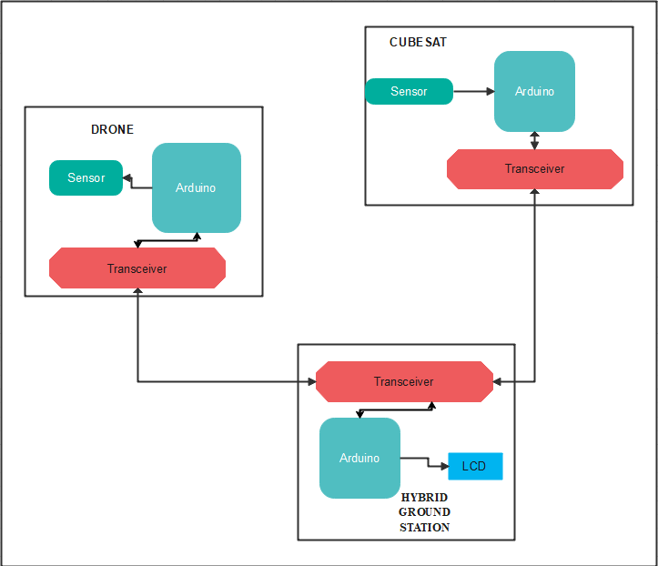
Block diagram

Slide 11
Methodology
Components required:
Hardware requirements:
1. Arduino Uno
2. Transmitter/Receiver (nrf24l01+pa+lna)
3. LCD (20X4 I2C/IIC LCD)
4.Digital Temperature and Humidity Sensor (DHT11)
Software requirements:
1.Arduino IDE

Slide 12
Implementation details
The design implementation of a hybrid ground station for drones and satellites provides structured information that can be used to analyze and monitor the impact of product trends on the components and concentration of elements in the electronics of the ground station.
A hybrid ground station refers to a system that combines the capabilities of both drones and satellites for communication, data transmission, or other purposes. The design implementation of such a ground station involves integrating various hardware and software components to enable seamless communication and interaction between drones and satellites.
In terms of hardware components, the design implementation may include antennas, receivers, transmitters, amplifiers, and other communication equipment. These components are essential for establishing and maintaining communication links with both drones and satellites.
The software components of the ground station may involve specialized communication protocols, signal processing algorithms, data management systems, and control interfaces. These software components facilitate the exchange of data and commands between the ground station, drones, and satellites.

Slide 13
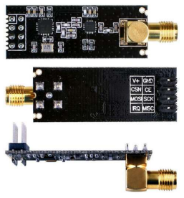
HARDWARE REQUIREMENTS
Transmitter/Receiver (nrf24l01+pa+lna)
The NRF24L01+PA+LNA is a wireless transceiver module that operates at 2.4GHz. It is a popular module for wireless communication due to its low power consumption, small size, and ease of use.

Slide 14
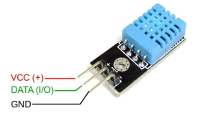
HARDWARE REQUIREMENTS
Digital Temperature and Humidity Sensor (DHT11)
The DHT11 sensor is a temperature and humidity sensor that is commonly used in a variety of applications. It is a low-cost sensor that is easy to use and provides reliable readings. The DHT11 sensor is a digital sensor that uses a single wire to transmit data. It is easy to use and provides accurate readings

Slide 15
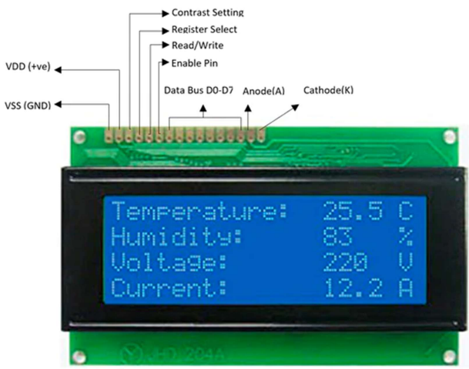
HARDWARE REQUIREMENTS
LCD (20x4 I2C/IIC LCD)
The 20x4 I2C LCD display is a popular display module that is used in a variety of applications. It is a low-cost display that is easy to use and provides a clear and easy-to read display.

Slide 16
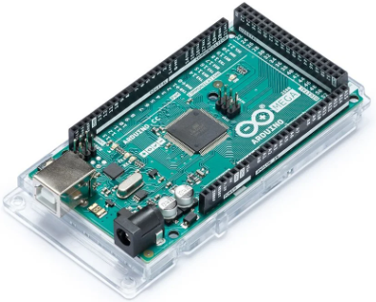
HARDWARE REQUIREMENTS
Arduino Mega
The Arduino Mega is a versatile microcontroller board that provides an extensive range of features and capabilities for electronics enthusiasts and professionals alike. It is based on the ATmega2560 microcontroller, which offers a significant upgrade in terms of resources compared to its predecessor, the Arduino Uno.

Slide 17
SOFTWARE REQUIREMENTS
ARDUINO IDE
The Arduino IDE (Integrated Development Environment) is a software platform used for programming and developing applications for Arduino boards. Arduino is an open-source electronics platform that allows users to create interactive projects and prototypes.
The Arduino IDE provides a user-friendly interface for writing, compiling, and uploading code to Arduino boards. It is compatible with various operating systems, including Windows, macOS, and Linux, making it accessible to a wide range of users.

Slide 18
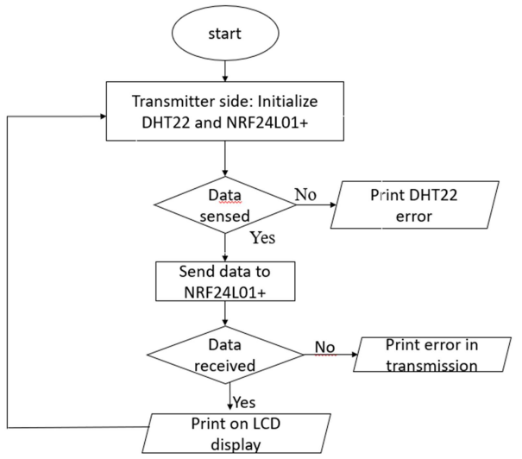
Flow chart

Slide 19
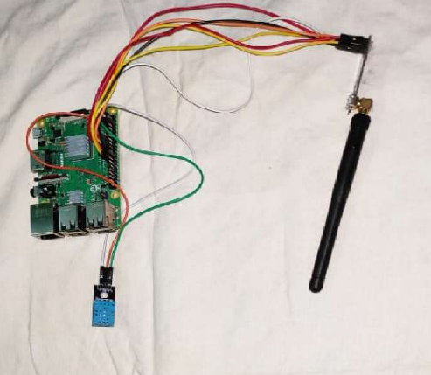
Results
fig a

Slide 20
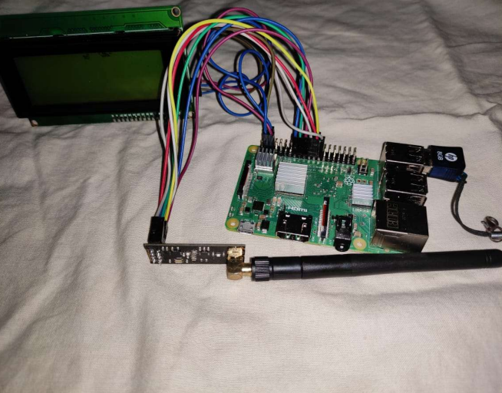
Results
fig b

Slide 21
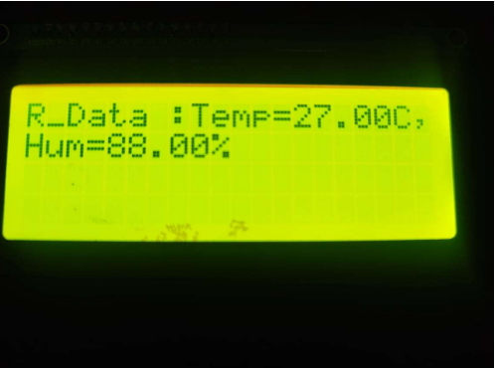
Results
Fig c
The measured DTTH11 sensor’s data from the drone is received and displayed on LCD. Fig a shows the communication towards transmitter side. Fig b shows the communication towards receiver side.

Slide 22
Work Pending/ Future work
Establish the transmission of data from the CubeSat to the ground station. the satellite needs to receives data from its onboard devices, such as sensors or cameras. This data is then converted into radio frequency (RF) signals and modulated for efficient transmission. The satellite's transmitting antenna sends the modulated RF signals towards the specific ground station. The ground station, equipped with a antenna, captures and demodulates the RF signals to extract the original data. Finally, the received data is processed and displayed on lcd

Slide 23
Usefulness/Advantages of the work/learnings from the work
Real-time data collection: The ground station captures temperature and humidity data in real-time, providing immediate access to environmental information.
Environmental monitoring: Continuous assessment of weather conditions and identification of risks are enabled by the ground station, ensuring safe drone operation.
Performance optimization: By analyzing the DHT11 sensor data, the ground station optimizes the drone's performance based on temperature and humidity conditions.
Safety and maintenance: Abnormal readings detected by the ground station alert operators to potential issues, allowing for timely maintenance actions

Slide 24
Reference
[1] K. Domain, E. Marin and I. Symeonidis, "Security Analysis of the Drone Communication Protocol: Fuzzing the MAVLink protocol" in Kasteelpark Arenberg 10 B-3001, Leuven-Heverlee, Belgium. Pulished in the year 2018.
[2] “ Securing the MAVLink Protocol for Ardupilot/PX4 Unmanned Aerial Systems” Azza Allouch, Omar Cheikhrouhou, Anis Koubaa, Mohamed Khalgui, Tarek Abbes. Published in the year 2019.
[3] “Energy-Efficient Cellular-Connected UAV Swarm Control Optimization” Yang Su, Hui Zhou, Yansha Deng and Mischa Dohler. Published in the year 2023.
[4] “Security Analysis of the Drone Communication Protocol: Fuzzing the MAVLink protocol” Karel Domin Eduard Marin Iraklis Symeonidis KU Leuven ESATCOSIC and iMinds Kasteelpark Arenberg 10, B-3001 Leuven-Heverlee, Belgium. Published in the year 2016.

Slide 25
Reference
[5]” Drone Ground Control Station with Enhanced Safety Features” Syed Razwanul Haque, Robi Kormokar Department of Electrical and Electronic Engineering Metropolitan University, Sylhet, Bangladesh. Published in the year 2017.
[6] “ Design and Development of Ground Control System for Tethered UAV”, Xiao Liang; Shirou Zhao; Guodong Chen; Guangbo Tong; Linping Jiang; Wei Zhang. Published in the year 2019.
[7] Daniel Perez Rodriguez, Ivan Maza, Fernando Caballero and David Scarlatti, "A Ground Control Station for a Multi-UAV Surveillance System", Journal of Intelligent and Robotic Systems, vol. 69, no. 1-4, pp. 119- 130. Published in the year of 2012.
[8] Zong Qun, Wang Dandan, Shao Shikai, Zhang Boyuan and HAN Yu, "Research status and development of multiUAV coordinated formation flight control", Harbin Gongye Daxue Xuebao/Joumal of Harbin Institute of Technology, vol. 49, no. 3, pp. 1-14. Published in the year of2017

